Slide 1
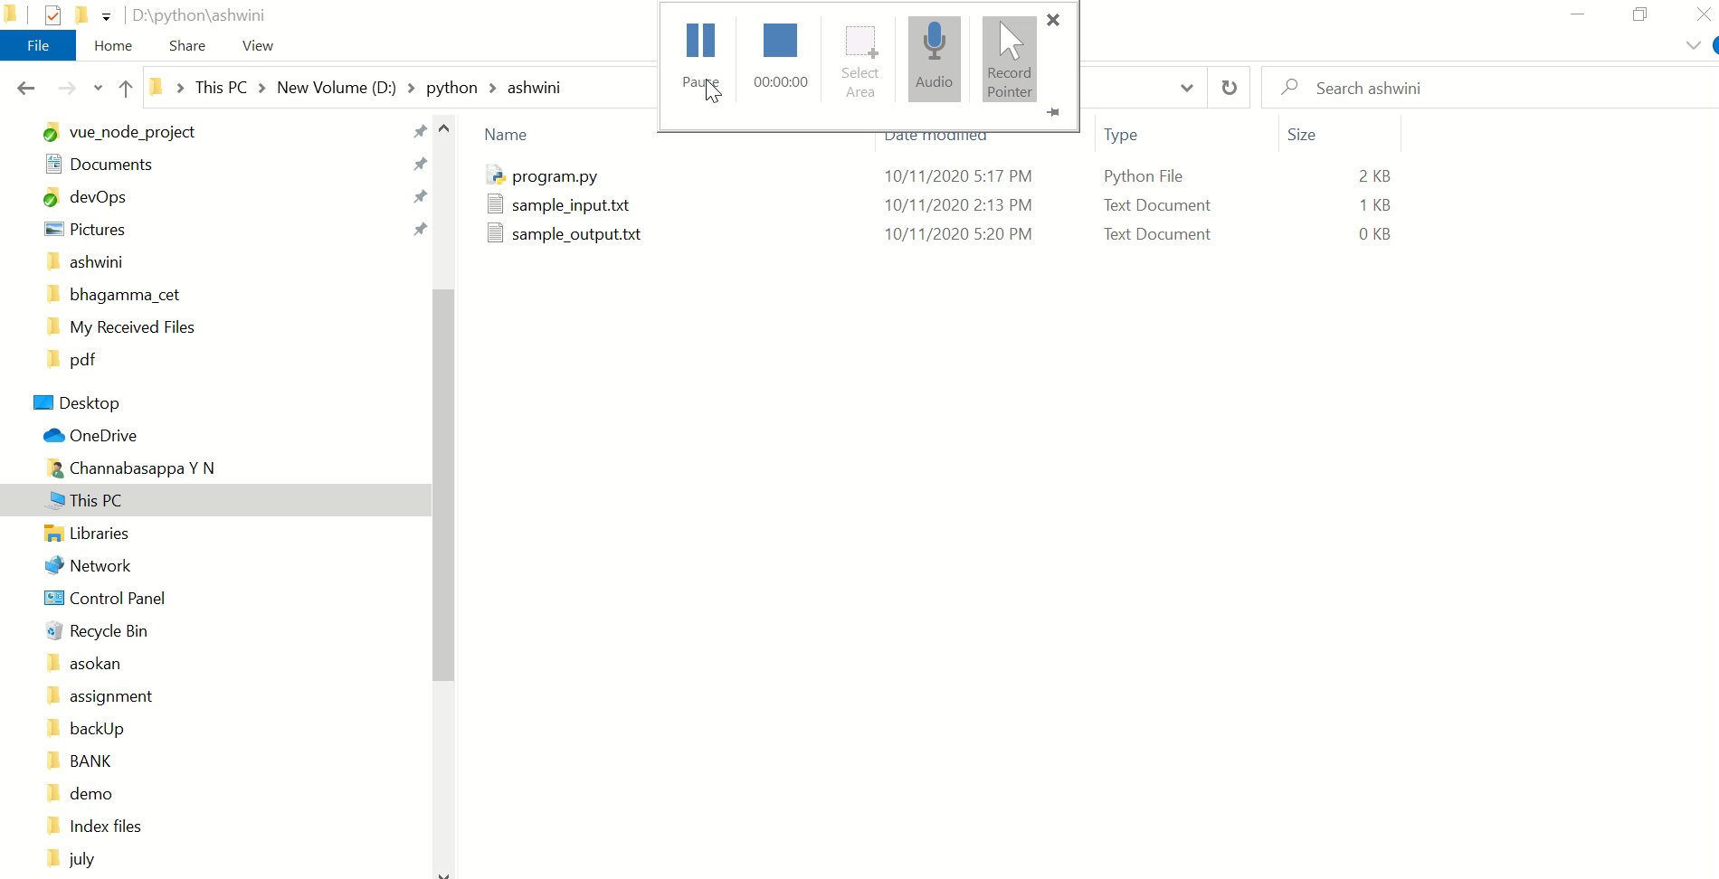
Assignment
Goodies delimma

